Slide 1

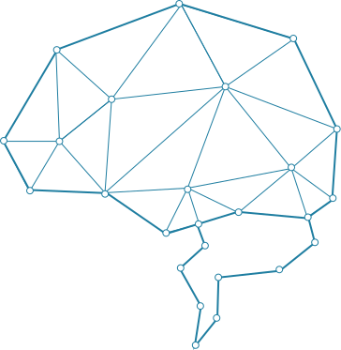
AI-NLP
CAPACITY BUILDING
CHED - LAKAS Capacity Building
August 14-16, 2023

Slide 2
OBJECTIVES:
Enhance the capacity of Higher Education Institutions (HEIs) in AI-NLP (Artificial Intelligence - Natural Language Processing).
Provide comprehensive training and resources to HEIs, fostering an environment of innovation and research in AI-NLP.
Empower HEIs to actively contribute to the development and practical application of AI-NLP technologies.
Cultivate a thriving ecosystem of AI-NLP pioneers within HEIs.
CHED - LAKAS Capacity Building
August 14-16, 2023

Slide 3




HIGHER EDUCATION INSTITUTIONS (HEIs)
CHED - LAKAS Capacity Building
August 14-16, 2023

Slide 4
AI-NLP CAPACITY BUILDING: SCHEDULE
Day 1 Topics:
Activities and Exercises:
What is AI?
Introduction to NLP
Key concepts and techniques in NLP
Pre-Processing Pipeline
Part of speech tagging
Named Entity Recognition
Text Classification
Text preprocessing
Text Categorization
Sentiment Analysis
Topic Modelling
Day 2 Topics:
Topic Ideation
Topic Modelling
Neural Network and Deep learning in NLP
Question and Answering
Text generation
Conducting NLP-based research
Topic ideation
Drafting topic proposal

Slide 5

The Speaker
Dr. Rodolfo C. Raga Jr.
Activity Specialists:
Myron Darrel L. Montefalcon
Jay Rhald C. Padilla
CHED - LAKAS Capacity Building
August 14-16, 2023

Slide 6
DAY 1:
WHAT IS AI?
CHED - LAKAS Capacity Building
August 14-16, 2023

Slide 7

What is A.I. (Artificial Intelligence)?
A.I. is the ability of a machine to display human-like capabilities such as reasoning, learning, planning and creativity.
CHED - LAKAS Capacity Building
August 14-16, 2023
Notes:
First, what is AI? AI is the ability of a machine to display human-like capabilities. There are two modes of AI. First is the narrow or weak AI. These are designed for a specific task like playing chess or spam filtering. Then there is the so-called general o strong AI where the machine can really demonstrate a level human-like cognitive abilities like reasoning, learning, planning and even creativity. This latter AI is the one that we are deeply concerned with.

Slide 8
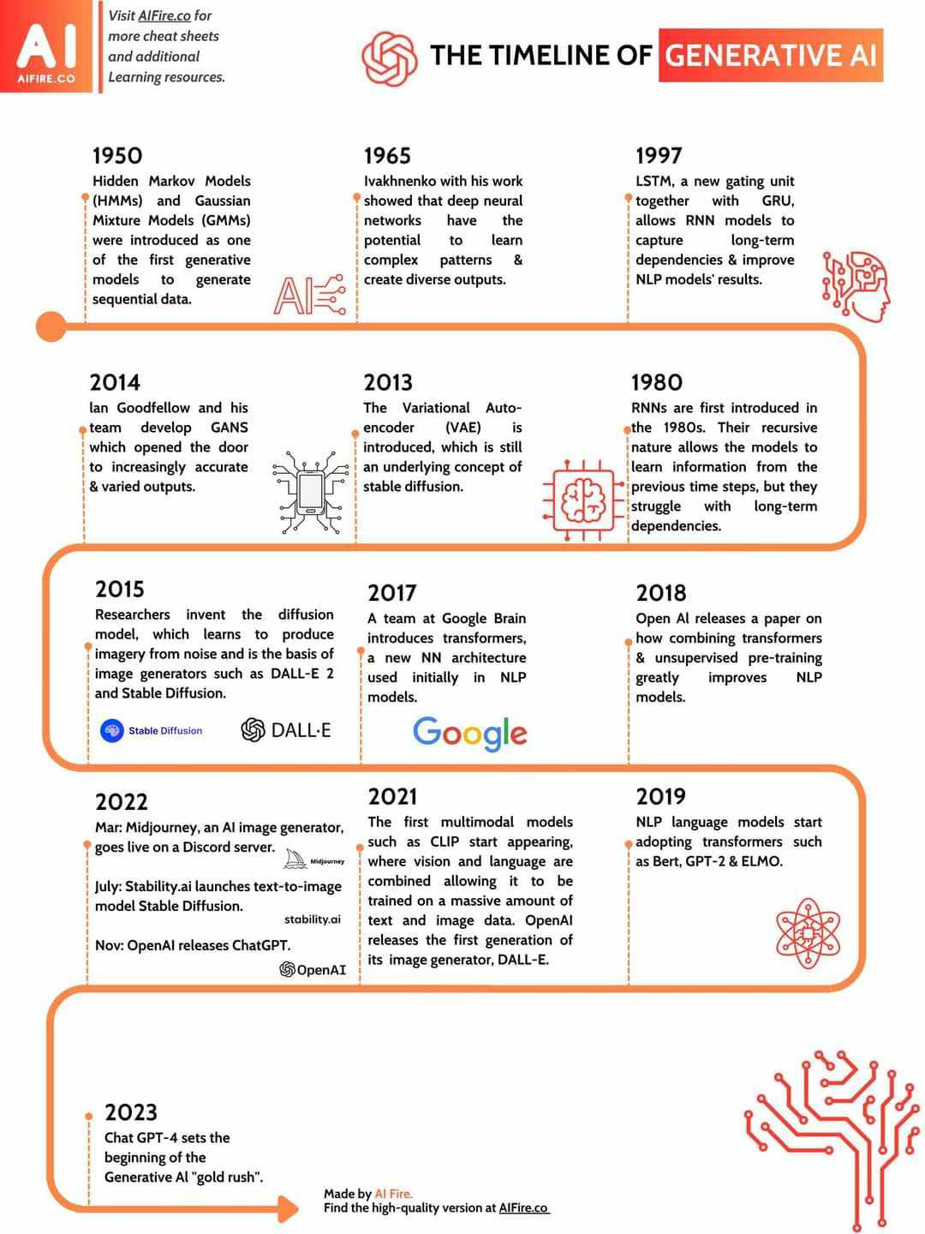

History of A.I. and Timeline of Technology Development
A.I. technologies been around for more than 50 years
Recent advances in computing power, coupled with the availability of huge volume of data and innovative algorithms, have triggered significant AI advancements that were once deemed impossible.
C-3PO
CHED - LAKAS Capacity Building
August 14-16, 2023
Notes:
This may also come as a surprise but AI is not a new technology, as the chart shows, A.I. has actually been around for more than 7 decades. But it is only now that it is making a real impact due to several factors like fast computers, complex algorithms and the huge amount of data. The best personification of a general AI is probably the robot C3P0 from starwars. Now, if someone were to tell me around 10 years ago that humanity would be able to create a robot as intelligent as C3p0 which can talk like a human using several languages on any topic. Many would probably laugh at it because its too difficult. But now, this kind of machine is already present in our society. It doesn’t look anything like c3po, but the capabilities are certainly the same.

Slide 9
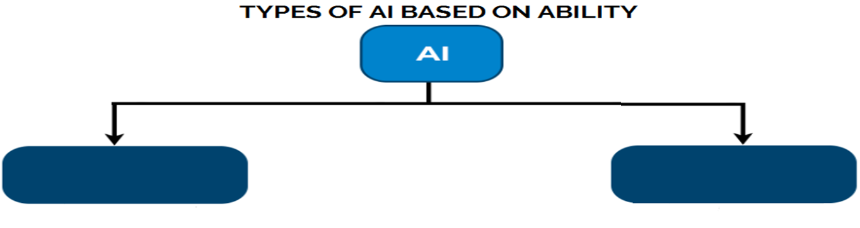
Narrow Weak) AI
General (Strong) AI
AI systems that are designed and trained for a specific purpose or task.
These AI systems excel in performing predefined tasks, such as language translation, image recognition, or playing chess.
Voice assistants like Siri and Alexa which respond to voice commands and perform specific tasks, as well as Generative models like ChatGPT are examples of Narrow AI.
is a hypothetical type of AI that possesses human-like cognitive abilities and can understand, learn, and perform any intellectual task that a human being can.
Artificial General Intelligence (AGI) would be able to understand and learn across a wide range of tasks and domains.
It would have the ability to apply knowledge to new situations. As of now, we have not achieved AGI..
CHED - LAKAS Capacity Building
August 14-16, 2023

Slide 10
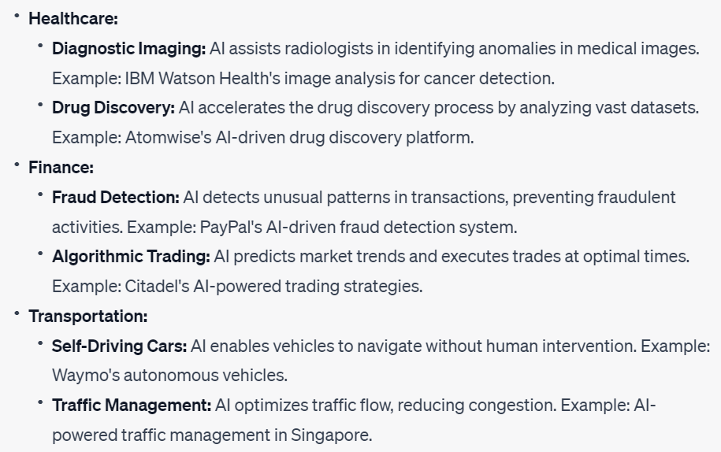
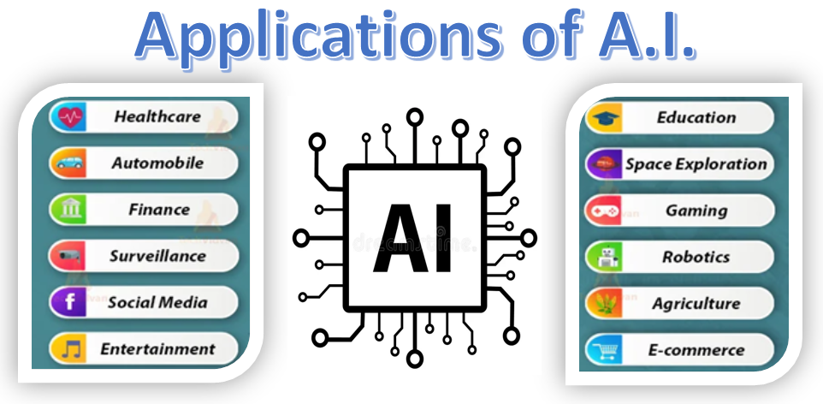
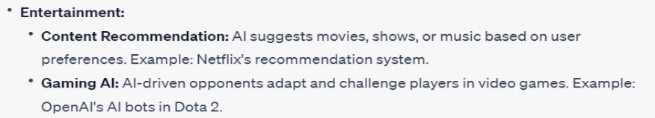
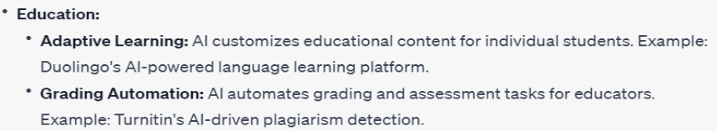
Real World Applications of AI
CHED - LAKAS Capacity Building
August 14-16, 2023

Slide 11
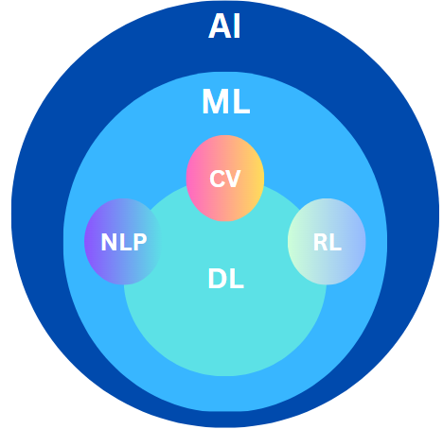
Foundation of AI’s Learning capabilities
NLP empowers AI to communicate with humans using language.
CV enables AI to "see" and interpret visual information.
RL helps AI learn optimal strategies through interactions, and
DL equips AI with the ability to learn .
Legend:
AI - Artificial Intelligence
ML- Machine Learning
DL - Deep Learning
NLP - Natural Language Processing
CV - Computer Vision
RL - Reinforcement Learning
CHED - LAKAS Capacity Building
August 14-16, 2023

Slide 12
What is Machine Learning?
Machine learning is the process of teaching a computer to learn from data.
It's a means for computers to recognize complex patterns embedded in the data and make decisions based on those patterns.
The algorithms used in machine learning can adjust and improve themselves as they're exposed to more and more data.
So, rather than programming a computer with a step by step instructions, you're letting it learn and make decisions on its own based on the examples it's given.
AI
Machine Learning
CHED - LAKAS Capacity Building
August 14-16, 2023

Slide 13
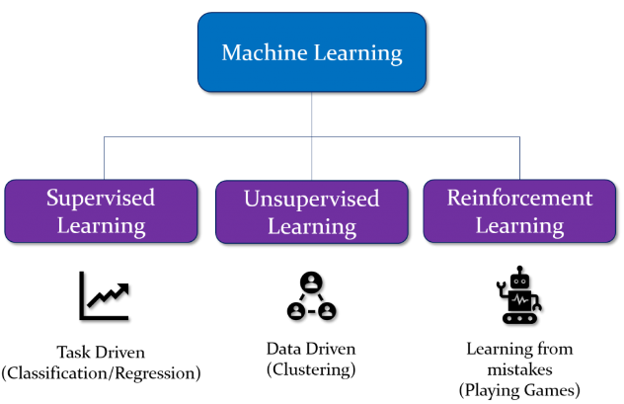
Types of Machine Learning?
Supervised Learning: The model learns from labeled data (input data with corresponding correct output labels). The model learns the mapping between inputs and outputs, so it can make accurate predictions or classifications.
Unsupervised Learning: Deals with unlabeled data (input data with no corresponding correct output labels). The model tries to find patterns or structure in the data without being given explicit output labels. Clustering and dimensionality reduction are common tasks in unsupervised learning.
Reinforcement Learning: Reinforcement learning makes an agent learn how to make decisions by interacting with an environment. The agent receives feedback in the form of rewards or penalties based on its actions.
Uses Labeled Data
Uses Unlabeled Data
Uses Carrot and Stick
CHED - LAKAS Capacity Building
August 14-16, 2023

Slide 14
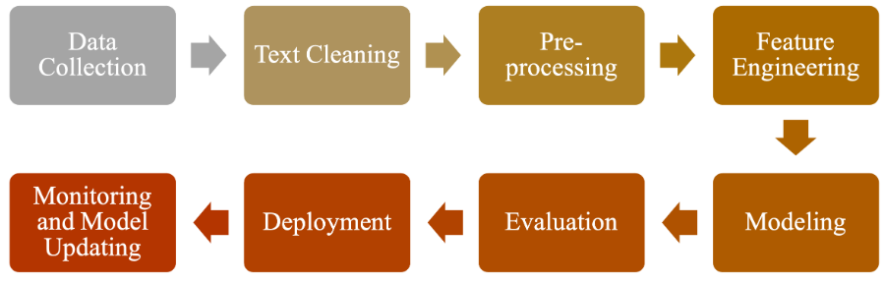
Machine Learning enables NLP
Machine learning is the tool used to teach computers to understand and use human language.
Machine Learning in NLP is about teaching computers to understand human language by giving them examples, adjusting their learning settings, and then using their learning to make predictions on new data.
AI
Machine Learning
NLP
CHED - LAKAS Capacity Building
August 14-16, 2023

Slide 15
DAY 1:
INTRODUCTION TO
NATURAL LANGUAGE PROCESSING (NLP)
CHED - LAKAS Capacity Building
August 14-16, 2023

Slide 16
Topics: Introduction to Natural Language Processing (NLP)
Definition of NLP
Why learn Natural Language Processing?
Areas of Active Research
Fundamentals of Linguistics
Overview of NLP Core Tasks and Applications
Challenges in NLP
Current State of NLP in the Philippines
Potential of NLP in the Philippines
CHED - LAKAS Capacity Building
August 14-16, 2023

Slide 17
Definition of NLP
Natural language Processing is a branch of AI that deals with written and spoken natural language information.
It concerns with gathering, manipulating, storing, retrieving, classifying, and making sense of written and spoken natural language information.
The goal of NLP is to develop applications that can interact directly with people using Human Language.
Alternative names include:
Computational Linguistics (CL)
Language Technology (LT)
Human Language Technology (HLT)
CHED - LAKAS Capacity Building
August 14-16, 2023

Slide 18
Why Learn NLP?
Communication: NLP enables chatbots and virtual assistants to understand users, improving interaction.
Data Insights: NLP processes text data for insights, aiding data-driven decisions.
Sentiment Analysis: NLP gauges sentiment for better marketing and reputation management.
Translation: NLP facilitates cross-lingual communication and localization.
Virtual Assistants: NLP powers voice-controlled assistants for convenience.
Text Generation: NLP automates content creation and report generation.
Job Opportunities: With the growing importance of AI and technology, NLP skills can lead to exciting career paths in fields like AI, data science, and programming.
CHED - LAKAS Capacity Building
August 14-16, 2023

Slide 19



















COMPANIES with NLP INITIATIVES
Notes:
These companies wants to make their services smarter at understanding natural language.
They often look at NLP as a key to unlocking the business value buried in unstructured text, a gold mine that many companies have yet to tap into.
Apple is seeking engineers fluent in Japanese, Norwegian, Turkish, Danish, Australian English, Arabic,Brazilian Portuguese, Swedish, Dutch, Thai, Russian, British English, and Cantonese.

Slide 20
AREAS OF ACTIVE RESEARCH
Category | Topic Area | Description
Small | Multilingual NLP: Enhancing models to work effectively with multiple languages. Ethical NLP: Addressing bias, fairness, and ethical concerns in NLP applications. Domain Adaptation: Developing models that can adapt knowledge from one domain to another. | focused areas of research and development within NLP, each with a specific scope and emphasis.
Medium | Named Entity Recognition: Involves improving models to identify and categorize entities like names, dates, and locations in text. Sentiment Analysis: Enhancing models to understand and classify sentiments in text. Text Classification: Developing models for categorizing text into predefined classes or categories. Machine Translation: Advancing techniques for translating text from one language to another. Question Answering: Creating models that can understand and answer questions based on text. | covering essential aspects of language analysis and understanding.
Big | Language Understanding and Representation: This area covers the development of models that understand the deeper meaning, context, and semantics of text. Creating effective word embeddings and language representations is a core component of this research. Language Generation and Text-to-Text Tasks: This category encompasses a diverse range of tasks that involve generating human-like text. The focus is on developing models that can generate coherent and contextually relevant text. Dialog Systems and Conversational Agents: Building conversational agents that can engage in natural and meaningful interactions with users is a significant research area. It includes the development of chatbots, virtual assistants, and techniques for effective dialogue management. | broad implications across industries, enhancing human-computer interactions, with the potential to revolutionize the way we process and understand language.
CHED - LAKAS Capacity Building
August 14-16, 2023

Slide 21
Fundamentals of Linguistics
Syntax: Syntax studies sentence structure and the rules governing how words combine to form meaningful expressions
Example:
"The cat chased the mouse."
Syntax involves understanding the structure and rules of how words combine to form meaningful sentences. In this example, the syntax dictates that the subject (the cat) comes before the verb (chased), followed by the object (the mouse). Understanding syntax helps us identify the grammatical structure of a sentence and analyze the relationships between its components.
CHED - LAKAS Capacity Building
August 14-16, 2023

Slide 22
Fundamentals of Linguistics
Semantics: Semantics focuses on the study of meaning in language. It explores how words, phrases, and sentences convey information and represent concepts.
Example:
"The dog barked loudly."
Semantics focuses on the meaning of words, phrases, and sentences. In this example, the semantics tells us that the word "dog" refers to a four-legged animal, and "barked loudly" conveys the action of producing a loud sound. By understanding semantics, we can extract meaning from text and perform tasks like sentiment analysis or language translation.
CHED - LAKAS Capacity Building
August 14-16, 2023

Slide 23
Fundamentals of Linguistics
Pragmatics: Pragmatics deals with how language is used in context and how the speaker, the listener, and the surrounding situation influence meaning.
Example:
"Can you pass the salt?"
Pragmatics deals with the contextual dimension of language and how meaning is influenced by the speaker, listener, and situational factors. In this example, the direct purpose of the sentence is a question about someone's ability to pass the salt.
CHED - LAKAS Capacity Building
August 14-16, 2023

Slide 24
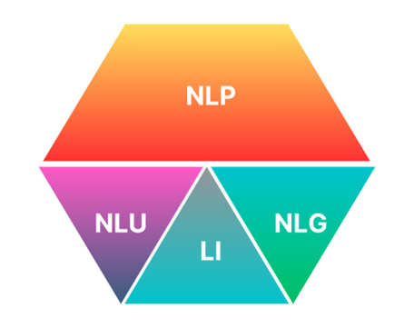
NLP Core Tasks
Natural Language Understanding (NLU) involves teaching computers to comprehend and interpret human language, enabling them to extract meaning, identify entities, and understand sentiment.
Natural Language Generation (NLG), on the other hand, focuses on teaching machines to generate human-like language, allowing them to communicate effectively and produce coherent text.
Language Interaction (LI) encompasses how humans and machines interact through languages, such as machine translation, content categorization, and topic modeling.
CHED - LAKAS Capacity Building
August 14-16, 2023

Slide 25
Challenges in NLP
Ambiguity
Ambiguity is inherent in human language and poses a significant challenge for NLP systems. Words and phrases often have multiple meanings, and sentences can be interpreted differently based on the context. Resolving ambiguity requires advanced techniques such as context analysis, semantic disambiguation.
For example:
"bank" can refer to a financial institution or the edge of a river. Understanding the intended meaning requires analyzing the context in which the term is used.
"Time flies like an arrow." Here, the word "flies" can be interpreted as a verb (to move through the air) or a noun (insects). Disambiguating such phrases requires understanding the surrounding words and their relationship to disentangle the intended meaning.
CHED - LAKAS Capacity Building
August 14-16, 2023

Slide 26
Other Challenges in NLP
Achieving Human-like Comprehension and Reasoning: Developing NLP models that can truly understand and reason like humans, which involves a deep understanding of context, inference, and common sense reasoning.
Generating Coherent and Contextually Relevant Responses: Creating NLP systems that can generate responses in natural language that are coherent, contextually appropriate, and contextually aligned with the conversation.
Understanding Context: Building models that can understand and maintain context over longer conversations or texts, ensuring accurate interpretations and appropriate responses.
Addressing Bias and Fairness: Developing NLP systems that are not only unbiased but also fair across different demographics, cultures, and languages, which requires careful data curation and model training.
Handling Low-Resource Languages: Creating effective NLP models for languages with limited available data and resources, which poses challenges in terms of data availability and model generalization.
CHED - LAKAS Capacity Building
August 14-16, 2023

Slide 27
Why is NLP Important for Filipino Students?
We know why NLP is important:
NLP technology plays a vital role in the current business arena.
NLP technology can assist in addressing the language problem in the country.
But how can we determine the state of awareness of students in NLP?
Raga (2016) offers insights into this matter
Roxas et al. (2021) provides an opportunity to verify our perspectives on the current trends.
Source: R Raga. 2016. Reflections on the awareness and progress of natural language processing (nlp) research in the Philippines. Philippine Computing Journal, 11(1):1– 9.
Roxas, Rachel Edita O., De La Cruz, Angelica, and Imperial, Joseph Marvin. (2021). Science Mapping of Publications in Natural Language Processing in the Philippines: 2006 to 2020. Pacific Asia Conference on Language, Information and Computation, 2021.
CHED - LAKAS Capacity Building
August 14-16, 2023
Notes:
The first is oriented towards preparing for one’s personal career enticing students with the prospect of financial gains...
The other, is more oriented towards service to others enticing students with more noble cause.
But both are equally good reasons to start spending efforts on NLP.

Slide 28
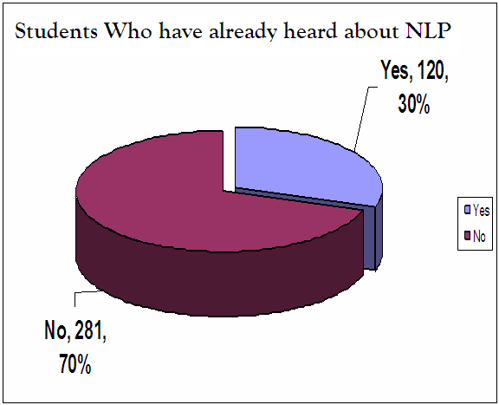
NLP Awareness in the Philippines
Awareness of NLP Technology
Yes | 120
No | 281
Total | 401
Notes:
Students’ awareness about the existence of current technology is very critical because it could affect their level of interest, which, in turn, could decide the outcome of the technical skills they will be able to develop.

Slide 29
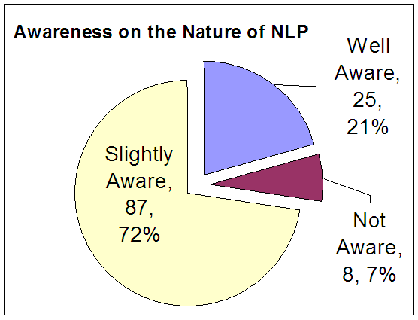
Notes:
One possible factor in fostering disinterest in any field of study is the misunderstandings that people may have about the discipline.

Slide 30
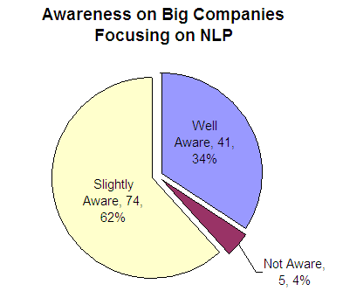
Notes:
It is also important for students to realize how a particular technology can benefit the lives of many people and society in general.

Slide 31
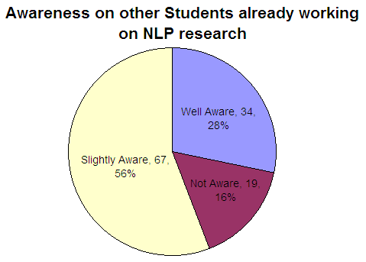

Slide 32
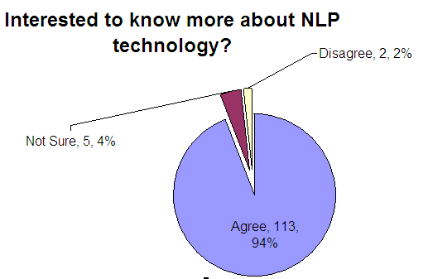

Slide 33
Status of NLP Research

Slide 34
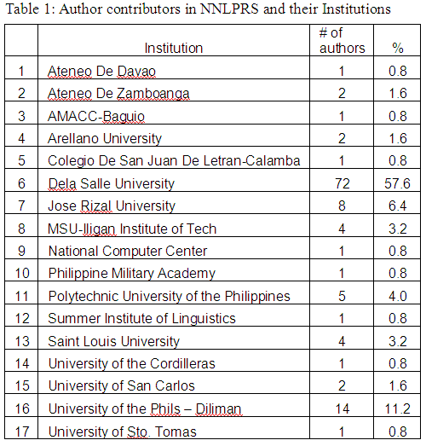
Status of NLP Research
CeLT Lab
Department of Linguistics

Slide 35
Status of NLP Research – NLP Labs and Point Person
Dr. Rachel Roxas
CeLT Lab
Jundy Raga
Department of Linguistics
Ria Sagum
Miguel Dalos

Slide 36
Issues and Views
A deep lack of opportunity to engage in NLP research among Filipino students.
A serious lack of NLP advocates in HEIs
Lack of needed facilities that can support research activities
Notes:
It is important to understand the reason for such lack of interest. The disinterest of the students can be traced on their fear of NLP.
I feel and think that all these fears are mainly based on the misunderstanding of what the concept of nlp research is all about.
What we need are champions to take the lead and help establish the initial communication channels in HEIs, then we
need to setup a much broader collaboration between these champions
We also need to setup facilities that will aid in consolidating research and development activities.

Slide 37
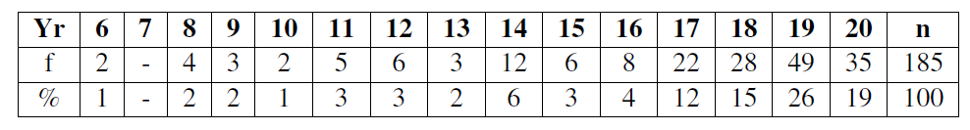
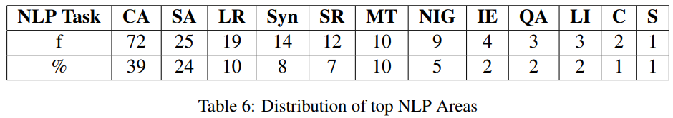
Summary of findings of (Roxas et al, 2021)
There is consistent increase in NLP publications, however, very few papers of 185 were produced within the period of investigation.
Most research is on text processing using Twitter mainly on classification and analysis, and sentiment analyses.
Notes:
It is important to understand the reason for such lack of interest. The disinterest of the students can be traced on their fear of NLP.
I feel and think that all these fears are mainly based on the misunderstanding of what the concept of nlp research is all about.
What we need are champions to take the lead and help establish the initial communication channels in HEIs, then we
need to setup a much broader collaboration between these champions
We also need to setup facilities that will aid in consolidating research and development activities.

Slide 38
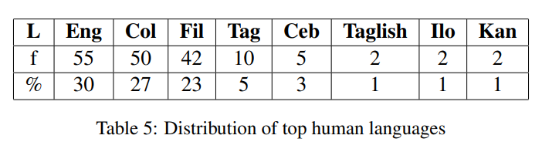
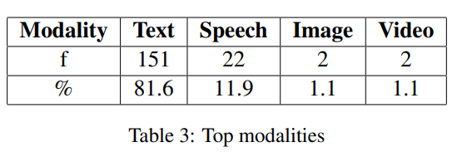
Summary of findings of (Roxas et al, 2021)
room to explore more of the 186 established Philippine languages.
The results indicate possible work on other modalities, NLP tasks, and Philippine languages, as research gaps that researchers may further explore on.
Expansion to other Philippine universities and overseas can be explored.
Notes:
It is important to understand the reason for such lack of interest. The disinterest of the students can be traced on their fear of NLP.
I feel and think that all these fears are mainly based on the misunderstanding of what the concept of nlp research is all about.
What we need are champions to take the lead and help establish the initial communication channels in HEIs, then we
need to setup a much broader collaboration between these champions
We also need to setup facilities that will aid in consolidating research and development activities.

Slide 39
DAY 1:
KEY CONCEPTS & TECHNIQ﻿UES IN NLP
CHED - LAKAS Capacity Building
August 14-16, 2023

Slide 40
Topics: Key Concepts and Techniques in NLP
Overview of Steps involved in NLP
Data Collection
Text Preprocessing
Text Representation
Model Building
Model Deployment and Performance Evaluation
CHED - LAKAS Capacity Building
August 14-16, 2023

Slide 41
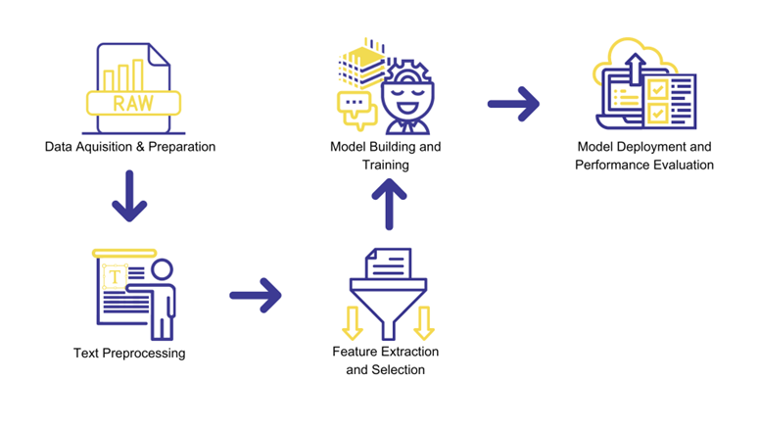
Overview of Steps Involved in NLP
CHED - LAKAS Capacity Building
August 14-16, 2023

Slide 42
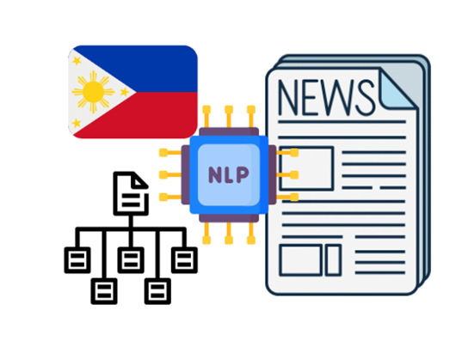
Demo: Filipino News Classification Model from Scratch
Let's try to learn the common steps in NLP by creating a Filipino News Classification model.
CHED - LAKAS Capacity Building
August 14-16, 2023

Slide 43


SCAN THE QR CODES
Download the dataset here:
Download the Python Notebook file here:
If unable to download, we will provide you the needed data.
CHED - LAKAS Capacity Building
August 14-16, 2023

Slide 44



The Data
Data provides the foundation on which NLP models learn language patterns, semantics, and context. Without sufficient and diverse data, NLP models would struggle to generalize and perform effectively on various language tasks.
CHED - LAKAS Capacity Building
August 14-16, 2023

Slide 45



Common Data Collection Methods
Web Scraping
Data
Collection
Methods
Survey
Sensors and IoTs
APIs
CHED - LAKAS Capacity Building
August 14-16, 2023

Slide 46
Example Data Sources
Kaggle Datasets (www.kaggle.com/datasets)
UCI Machine Learning Repository (archive.ics.uci.edu/ml/index.php)
Common Crawl (commoncrawl.org)
Google Dataset Search (datasetsearch.research.google.com)
Stanford NLP Group (nlp.stanford.edu/links/statnlp.html)
CHED - LAKAS Capacity Building
August 14-16, 2023

Slide 47
Text Preprocessing Pipeline
A crucial first step in NLP where we clean and transform raw text data to make it easier for computers to understand.
Text preprocessing is like tidying up messy text so that computers can read and understand it more easily
CHED - LAKAS Capacity Building
August 14-16, 2023

Slide 48


Text Preprocessing
tHiS is an ExamplE! nLP iS FuN
Lowercasing
Special Character Removal
Stopword Removal
Tokenization
[
"example",
"nlp",
"fun"
]
CHED - LAKAS Capacity Building
August 14-16, 2023

Slide 49
Text Representation and Feature Extraction
Text data is inherently unstructured, making it difficult for computers to directly process. Text representation involves transforming text into numerical or structured formats that algorithms can comprehend. This conversion is necessary because most machine learning models require numerical inputs. Common text representation techniques include:
Bag of Words (BoW):
TF-IDF (Term Frequency-Inverse Document Frequency)
Word Embeddings:
CHED - LAKAS Capacity Building
August 14-16, 2023

Slide 50
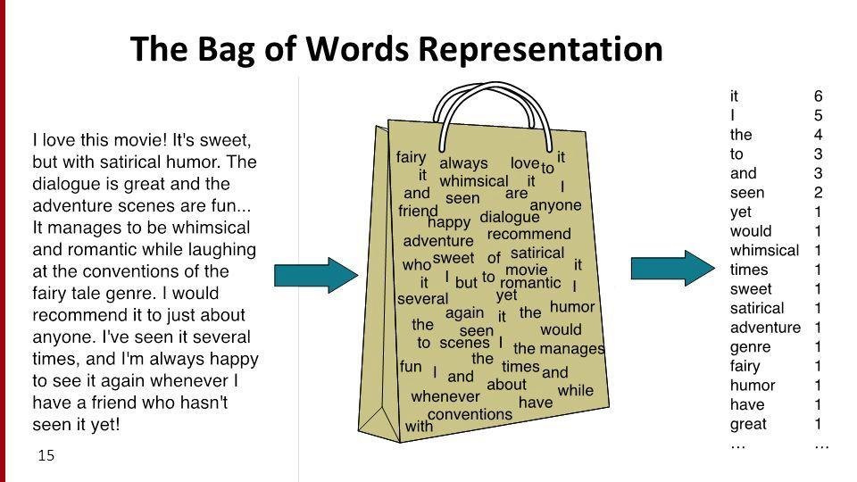
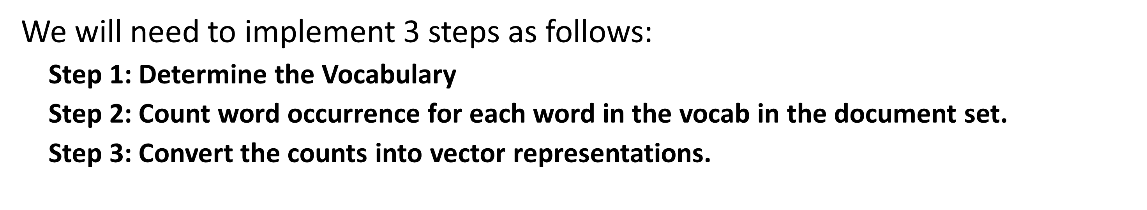
Bag-of-Words (BoW)
The bag-of-words (BOW) model is a simplifying representation used in natural language processing.
BOW turns arbitrary text into fixed-length vectors by counting how many times each word appears. This process is often referred to as vectorization.
This representation disregards grammar and even word order because it only tells you what words occur in the document, not where they occurred.
CHED - LAKAS Capacity Building
August 14-16, 2023

Slide 51
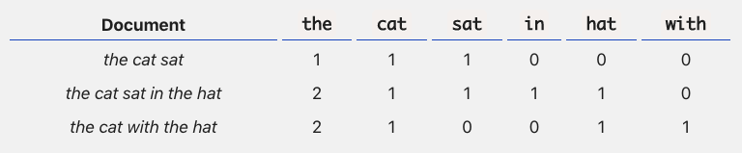
BoW Implementation
Extracted Vocabulary (the, cat, sat, in, the, hat, with)
the cat sat
the cat sat in the hat
the cat with the hat
Step 2: Count word occurrence
CHED - LAKAS Capacity Building
August 14-16, 2023

Slide 52
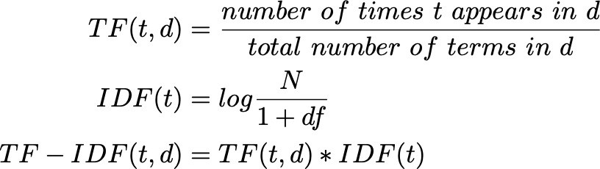
TF-IDF representation
TF-IDF stands for “Term Frequency — Inverse Document Frequency”.
This technique quantifies the value of words in a set of documents by computing a score for each word to signify its importance in the document and corpus.
This method is a widely used technique in Information Retrieval and Text Mining.
The computations for TF-IDF is more complex than the BoW model.
TF-IDF can be broken down into two parts:
TF (term frequency) and
IDF (inverse document frequency).
Term Frequency looks at the frequency of a particular term you are concerned with relative to the document (raw count).
Inverse Document Frequency looks at how common (or uncommon) a word is amongst the corpus.
The reason IDF is needed is to help minimize the weighting of frequent terms while making infrequent terms have a higher impact.

Slide 53
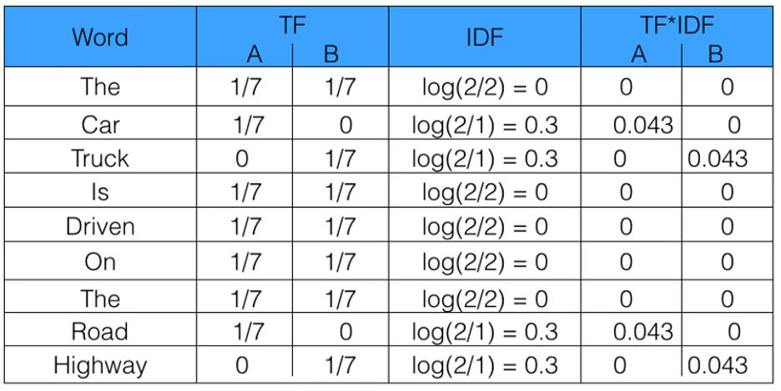
Example TF-IDF Implementation
For example, given the two sentences each represent a document:
A = “The car is driven on the road”;
B = “The truck is driven on the highway” I
The last column provides the vector representation for each document. This vector would have a TF-IDF score for every word in the entire collection of documents. Once these vectors are generated, they can applied to various NLP applications.
CHED - LAKAS Capacity Building
August 14-16, 2023

Slide 54
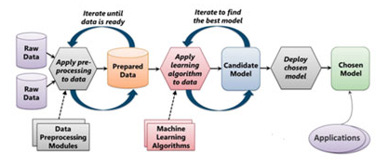
Model Selection and Training
Model selection and training in NLP is the process of choosing the best model for a given task and then training that model on a dataset of text.
CHED - LAKAS Capacity Building
August 14-16, 2023
Notes:
Choose a set of candidate models. There are many different types of models that can be used for NLP tasks. The choice of model will depend on the specific task that the model is being built for. Some common models used in NLP include support vector machines, decision trees, and neural networks.
Split the dataset into train, validation, and test sets. The train set will be used to train the model, the validation set will be used to evaluate the model during training, and the test set will be used to evaluate the model's final performance. It is important to use a separate validation set to evaluate the model during training, so that the model does not overfit to the train set.
Train the models on the train set. This is done by feeding the data to the model and adjusting the model's parameters until it makes accurate predictions on the train set. The training process can be computationally expensive, so it is important to choose a model that is appropriate for the size of the dataset.
Evaluate the models on the validation set. This is done to compare the performance of the different models and to choose the best model for the task. There are many different metrics that can be used to evaluate the performance of NLP models, such as accuracy, precision, recall, and F1 score.
Fine-tune the best model on the train set. Once the best model has been chosen, it can be fine-tuned by adjusting the model's parameters further. This can be done by feeding the data to the model multiple times and adjusting the parameters each time.
Evaluate the fine-tuned model on the test set. This is done to ensure that the model is still making accurate predictions on unseen data. If the model does not perform well on the test set, it may need to be retrained with a different set of parameters or a different dataset.
Deploy the model. Once the model has been evaluated and found to be accurate, it can be deployed in a production environment. This means that the model can be used to make predictions on new data.
The process of model selection and training in NLP can be complex and time-consuming. However, it is a critical step in creating a model that can understand and process human language accurately.

Slide 55
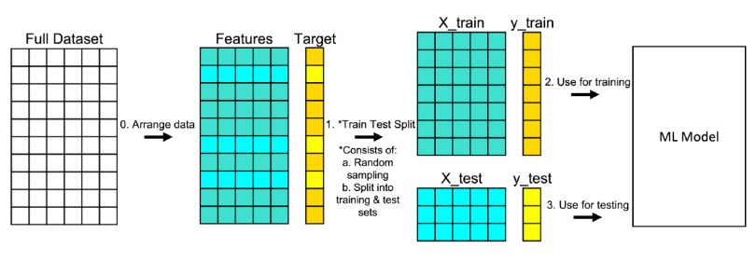
Training Data – The Train-Test Split
The model can be initially trained and fine-tuned on specific tasks or datasets using the training data. Afterwards, the final model's performance is evaluated using test data, which it has never seen before.
CHED - LAKAS Capacity Building
August 14-16, 2023
Notes:
Choose a set of candidate models. There are many different types of models that can be used for NLP tasks. The choice of model will depend on the specific task that the model is being built for. Some common models used in NLP include support vector machines, decision trees, and neural networks.
Split the dataset into train, validation, and test sets. The train set will be used to train the model, the validation set will be used to evaluate the model during training, and the test set will be used to evaluate the model's final performance. It is important to use a separate validation set to evaluate the model during training, so that the model does not overfit to the train set.
Train the models on the train set. This is done by feeding the data to the model and adjusting the model's parameters until it makes accurate predictions on the train set. The training process can be computationally expensive, so it is important to choose a model that is appropriate for the size of the dataset.
Evaluate the models on the validation set. This is done to compare the performance of the different models and to choose the best model for the task. There are many different metrics that can be used to evaluate the performance of NLP models, such as accuracy, precision, recall, and F1 score.
Fine-tune the best model on the train set. Once the best model has been chosen, it can be fine-tuned by adjusting the model's parameters further. This can be done by feeding the data to the model multiple times and adjusting the parameters each time.
Evaluate the fine-tuned model on the test set. This is done to ensure that the model is still making accurate predictions on unseen data. If the model does not perform well on the test set, it may need to be retrained with a different set of parameters or a different dataset.
Deploy the model. Once the model has been evaluated and found to be accurate, it can be deployed in a production environment. This means that the model can be used to make predictions on new data.
The process of model selection and training in NLP can be complex and time-consuming. However, it is a critical step in creating a model that can understand and process human language accurately.

Slide 56
Traditional Performance Evaluation
Performance evaluation assesses how well an NLP model performs on a given task. Proper evaluation is critical to ensure that the model meets the desired quality standards and effectively addresses the task's requirements.
Traditional performance metrics in NLP
Accuracy: The proportion of correct predictions over the total predictions. It's commonly used for classification tasks.
Precision and Recall: Relevant for tasks like text classification, precision measures the proportion of correctly predicted positive instances, while recall measures the proportion of actual positive instances correctly predicted.
F1 Score: A harmonic mean of precision and recall, providing a balanced evaluation for imbalanced datasets.
CHED - LAKAS Capacity Building
August 14-16, 2023

Slide 57
NLP Specific Performance Evaluation
There are also metrics that can be considered NLP-specific performance metrics because they are tailored to evaluate the performance of specific tasks within the field of NLP:
NLP performance metrics in NLP
BLEU Score: This metric evaluates the quality of translated text by comparing it to reference translations. BLEU is designed to assess the accuracy and fluency of translations.
Perplexity: Perplexity is used to evaluate language models by measuring how well a language model predicts the next word in a sequence.
ROUGE Score: This metric is designed for evaluating the quality of text summarization by assessing how well the generated summary captures the key information present in the reference summaries.
CHED - LAKAS Capacity Building
August 14-16, 2023

Slide 58
DAY 1:
TEXT CLASSIFICATION
CHED - LAKAS Capacity Building
August 14-16, 2023

Slide 59
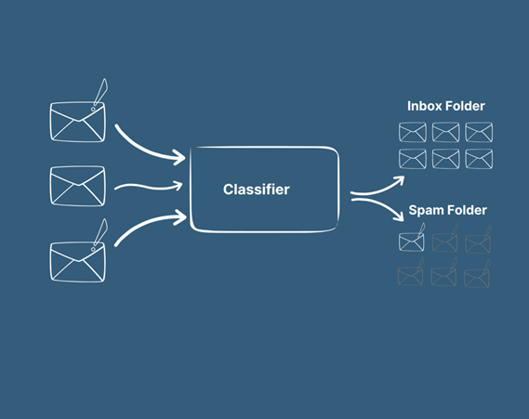
TEXT CLASSIFICATION
Text classification is a technique used in natural language processing (NLP) to sort and label different types of written documents automatically. It's an important part of many NLP applications, including tasks like figuring out the sentiment behind a text, detecting spam messages, classifying topics, and organizing documents.
CHED - LAKAS Capacity Building
August 14-16, 2023

Slide 60
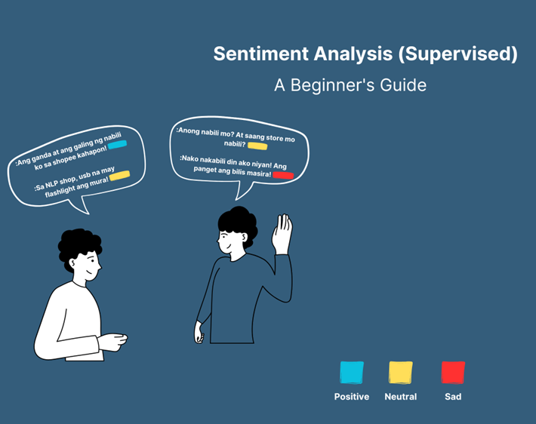
EXAMPLE OF TEXT CLASSIFICATION:
Sentiment analysis is a technique used to understand the emotions, attitudes, and opinions expressed in written text. It helps us figure out whether a piece of text is positive, negative, or neutral in terms of sentiment.

Slide 61
DAY 1:
NAMED ENTITY RECOGNITION
(NER)
CHED - LAKAS Capacity Building
August 14-16, 2023

Slide 62
John works at Apple Inc. in California and was born on July 10, 1985.
NAMED ENTITY
RECOGNITION
A concept in Natural Language Processing (NLP) that involves identifying and classifying named entities in text. Named entities are specific pieces of information, such as names of people, organizations, locations, dates, and more.
Person:"John"
Organization: "Apple Inc."
Location:"California"
Date: "July 10, 1985"
CHED - LAKAS Capacity Building
August 14-16, 2023

Slide 63

DAY 1:
BASICS OF NATURAL LANGUAGE PROCESSING (NLP)
LANGUAGE MODELING
A concept that focuses on understanding the structure and grammar of natural language. It's like teaching a computer how sentences are formed and what words are likely to come next based on the context of the sentence.
CHED - LAKAS Capacity Building
August 14-16, 2023

Slide 64
DAY 1:
BASICS OF NATURAL LANGUAGE PROCESSING (NLP)
LANGUAGE MODELING
Imagine you're reading a book, and you come across the sentence: "The sun rises in the ____."
As a human, you can easily predict that the missing word is likely to be "morning" because it fits well in the context of the sentence. Language modeling helps computers do a similar task but on a much larger scale.
CHED - LAKAS Capacity Building
August 14-16, 2023

Slide 65
DAY 1:
BASICS OF NATURAL LANGUAGE PROCESSING (NLP)
Examples: (Language Modeling)
Next Word Prediction: Given a sequence of words, a language model can predict the next word. For instance:
Input: "I love to eat ice ____"
Output: "cream"
Language Generation: Language models can generate coherent and meaningful sentences. For example:
Input: None (starting from scratch)
Output: "Once upon a time, in a faraway kingdom, there lived a brave knight."
Text Completion: Language models can fill in missing parts of a text. For instance:
Input: "Roses are red, violets are ____"
Output: "blue."
CHED - LAKAS Capacity Building
August 14-16, 2023

Slide 66


DAY 1:
BASICS OF NATURAL LANGUAGE PROCESSING (NLP)
I like to read books
PART OF SPEECH
a concept in NLP that refers to categorizing words in a sentence based on their grammatical roles. Think of it as assigning labels to words to understand their functions and relationships within the sentence.
Pronoun
Verb
Conjunction
Noun
CHED - LAKAS Capacity Building
August 14-16, 2023

Slide 67
DAY 1:
SUPERVISED
MACHINE LEARNING
CHED - LAKAS Capacity Building
August 14-16, 2023

Slide 68



DAY 1:
SUPERVISED MACHINE LEARNING
"You are beautiful" is a positive statement
SUPERVISED
MACHINE LEARNING
I see!!
Is a concept that involves teaching computers how to understand and process language by using labeled examples. It's like a teacher showing a student examples of sentences and telling them what each sentence means.
CHED - LAKAS Capacity Building
August 14-16, 2023

Slide 69

DAY 1:
SUPERVISED MACHINE LEARNING
SUPERVISED MACHINE LEARNING: PIPELINE
Gather Data
Extract Features
Train Model
Model Evaluation
Prediction
CHED - LAKAS Capacity Building
August 14-16, 2023

Slide 70
DAY 1:
SUPERVISED MACHINE LEARNING
SUPERVISED MACHINE LEARNING:
GATHERING DATA
bit.ly/codeHERE
download files using this link
CHED - LAKAS Capacity Building
August 14-16, 2023

Slide 71
DAY 1:
SUPERVISED MACHINE LEARNING
SUPERVISED MACHINE LEARNING:
Demo Time!
download files using this link
CHED - LAKAS Capacity Building
August 14-16, 2023

